Slide 1
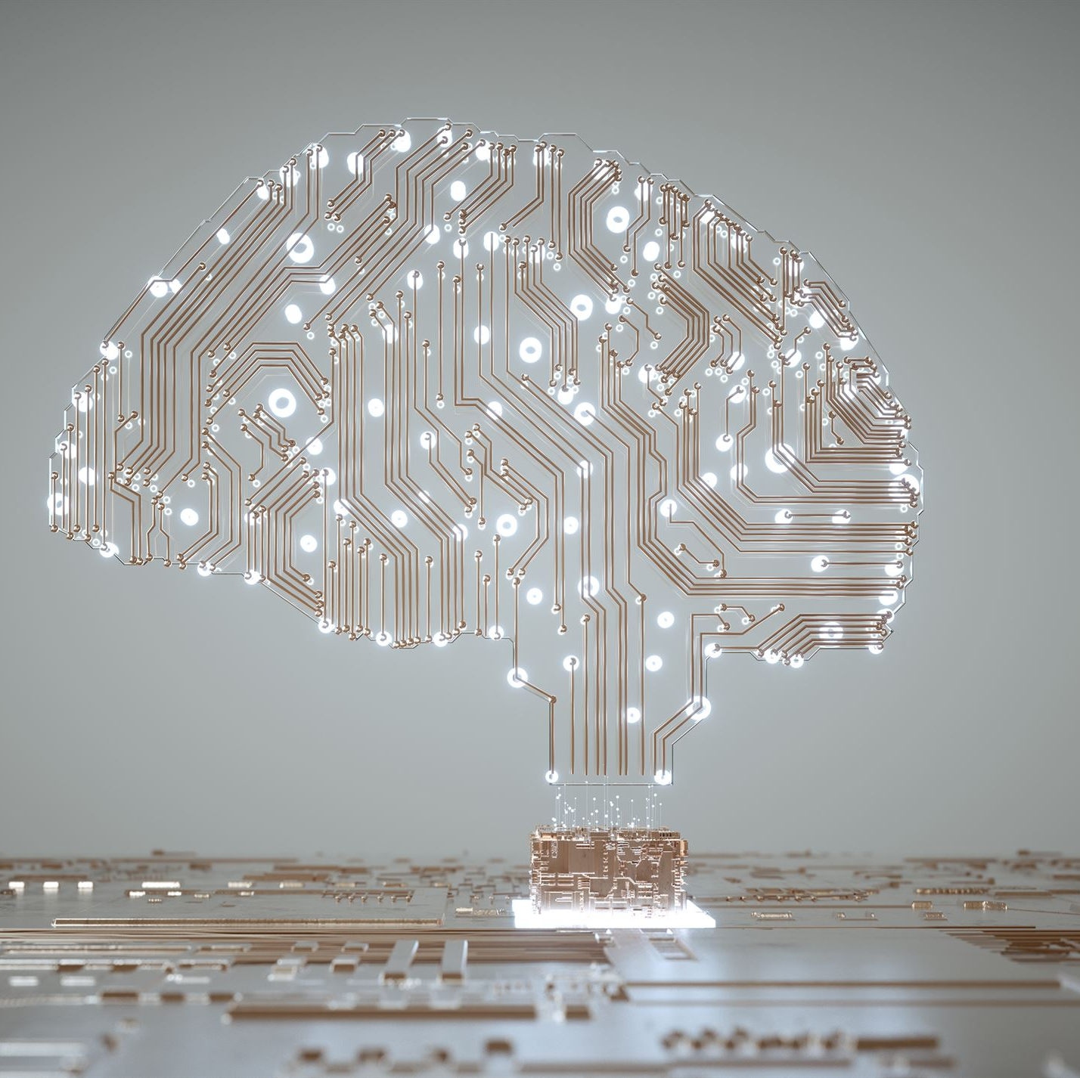
Building Blocks of Retrieval-Augmented Generation (RAG)
Exploring the Synergy of Retrieval and Generation Models
Notes:
AI-generated content may be incorrect. Retrieval-Augmented Generation (RAG) is an emerging field of Natural Language Processing (NLP) that combines the strengths of retrieval and generation models. In this presentation, we will explore the key components of RAG, its training and fine-tuning techniques, and its potential applications and challenges.

Slide 2
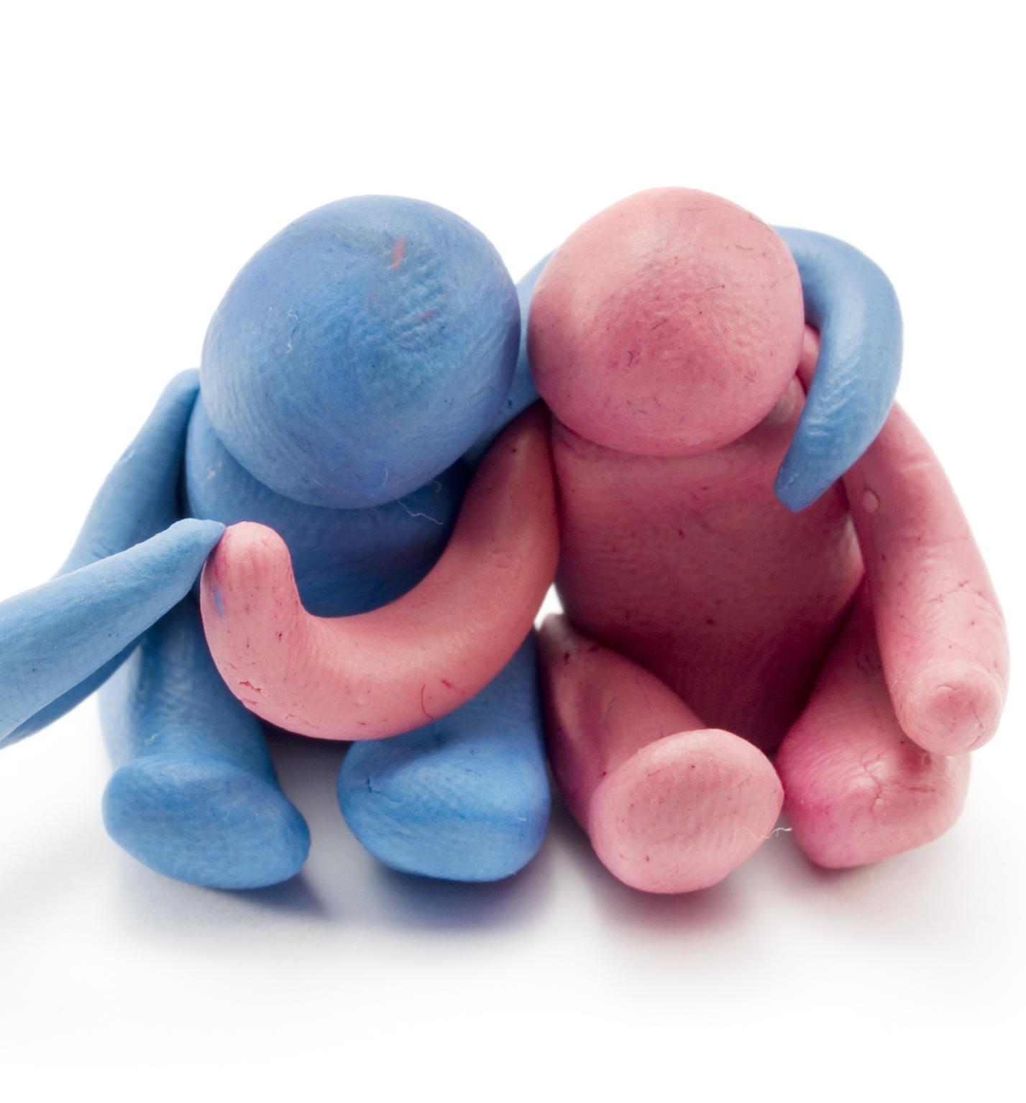
Outline
Introduction to Retrieval-Augmented Generation
Retrieval Component
Generation Component
RAG Training and Fine-Tuning
Applications and Use Cases
Future Directions and Challenges
Notes:
We will start by introducing the concept and importance of RAG in NLP. Then, we will delve into the retrieval and generation components of RAG, exploring the different models and techniques used. We will then discuss the training and fine-tuning process of RAG models, along with performance evaluation metrics. Finally, we will explore the various applications and use cases of RAG, along with the future directions and challenges of the field.

Slide 3
Introduction to Retrieval-Augmented Generation
Notes:
Retrieval-Augmented Generation (RAG) is a hybrid approach to NLP that combines retrieval and generation models to improve the quality of generated text. RAG models use a knowledge base or reference corpus to augment the generation process, improving its accuracy and relevance to the input context. RAG has become increasingly important in NLP, as it enables more natural and informative text generation.

Slide 4

Definition and Concept of RAG
RAG is a natural language processing technique that combines retrieval and generation models to produce more accurate and informative text. It enables more natural communication between humans and machines.
Notes:
RAG is a natural language processing technique that combines the strengths of retrieval and generation models. It uses a reference corpus or knowledge base to augment the generation process and produce more accurate and informative text. RAG has become an important tool in NLP, as it enables more natural communication between humans and machines.

Slide 5

Importance of RAG in Natural Language Processing
Accuracy and Informativeness
RAG models enable more accurate and informative text generation in NLP applications by augmenting the generation process with a reference corpus or knowledge base.
Context-Specific Text
RAG models produce more relevant and context-specific text by utilizing a reference corpus or knowledge base, which is particularly important in applications such as customer support and content generation.
Notes:
RAG has become an important tool in NLP, as it enables more accurate and informative text generation. By augmenting the generation process with a reference corpus or knowledge base, RAG models can produce more relevant and context-specific text. This is particularly important in applications such as customer support and content generation, where the quality of text output is paramount.

Slide 6

Overview of RAG Architecture
Retrieval Component
The retrieval component of RAG architecture is responsible for retrieving relevant information from a knowledge base or reference corpus to be used by the generation component for generating text output.
Generation Component
The generation component is responsible for generating text output using the information obtained from the retrieval component.
Integration of Components
The two components of RAG architecture are integrated to produce more accurate and informative text output.
Notes:
RAG models consist of two main components: the retrieval component and the generation component. The retrieval component retrieves relevant information from a knowledge base or reference corpus, while the generation component uses this information to generate text output. The two components are integrated to produce more accurate and informative text.

Slide 7
Retrieval Component
Notes:
The retrieval component of RAG models is responsible for retrieving relevant information from a knowledge base or reference corpus. This component uses a variety of algorithms and techniques to retrieve the most relevant information, such as keyword matching and semantic similarity. Some examples of retrieval models used in RAG include BM25, TF-IDF, and BERT-IR.

Slide 8

Knowledge Base and Data Sources
The knowledge base used in RAG models can be any dataset or collection of documents that contains relevant information for the task at hand. This can include structured databases, unstructured text corpora, and even web pages. The choice of the knowledge base depends on the specific application and the type of information required.
Notes:
The knowledge base or reference corpus used in RAG models can be any dataset or collection of documents that contains relevant information for the task at hand. This can include structured databases, unstructured text corpora, and even web pages. The choice of the knowledge base depends on the specific application and the type of information required.

Slide 9

Retrieval Algorithms and Techniques
Keyword Matching
Keyword matching is a retrieval algorithm that matches keywords in a query to keywords in a document, and retrieves documents with the highest number of matches.
Semantic Similarity
Semantic similarity is a retrieval algorithm that uses natural language processing to identify related words and concepts, and retrieves documents with the highest semantic similarity to the query.
Neural Networks
Neural networks are a machine learning technique used for retrieval in RAG models. They learn patterns in data and can retrieve documents with the highest probability of being relevant to a query.
Examples of Retrieval Algorithms
Some examples of retrieval algorithms used in RAG models include BM25, TF-IDF, and BERT-IR. BM25 is a probabilistic retrieval algorithm, TF-IDF is a term-weighting scheme, and BERT-IR is a neural retrieval algorithm based on the BERT model.
Notes:
RAG models use a variety of retrieval algorithms and techniques to retrieve relevant information from the knowledge base. These algorithms can be based on keyword matching, semantic similarity, or even neural networks. Some examples of retrieval algorithms used in RAG include BM25, TF-IDF, and BERT-IR.

Slide 10

Examples of Retrieval Models
BERT-IR
BERT-IR is a retrieval model used in RAG that encodes the query and documents using a pre-trained BERT model.
DPR
DPR is a retrieval model used in RAG that encodes the knowledge base and query using dense vector representations.
BM25
BM25 is a retrieval model used in RAG that is based on the traditional information retrieval technique using term frequency and inverse document frequency.
TF-IDF
TF-IDF is a retrieval model used in RAG that is based on the traditional information retrieval technique using term frequency and inverse document frequency.
Notes:
Some examples of retrieval models used in RAG include BERT-IR, which uses a pre-trained BERT model to encode the query and documents, and DPR, which uses dense vector representations to encode the knowledge base and query. Other models, such as BM25 and TF-IDF, are based on traditional information retrieval techniques.

Slide 11
Generation Component
Notes:
The generation component of RAG models is responsible for producing text output based on the relevant information retrieved by the retrieval component. This component can use a variety of language models and techniques to generate text, such as GPT-3 and T5. The output of the generation component is integrated with the retrieval component to produce more accurate and informative text.

Slide 12
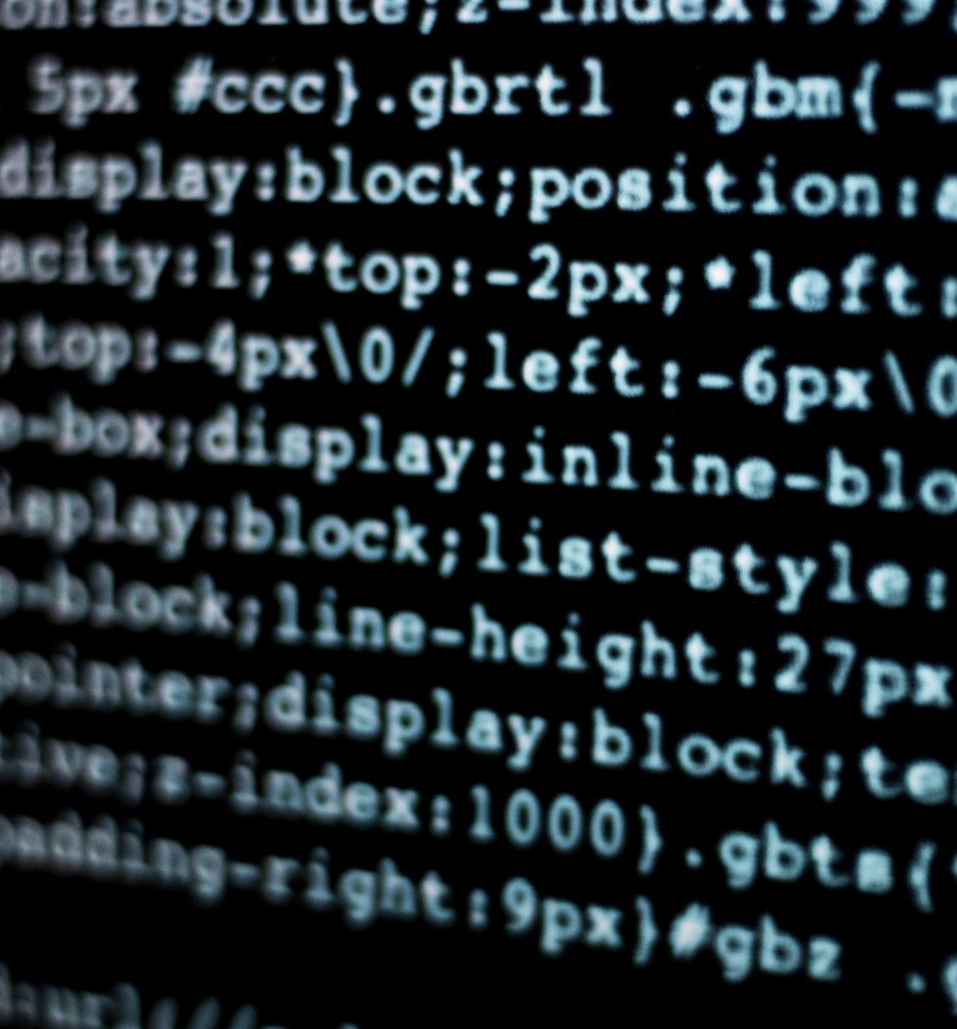
Language Models Used in Generation
N-grams and Language Models
N-grams and Language Models are traditional statistical models used in RAG models for generating text output. These models use statistical probabilities to predict the next word or sequence of words in a sentence.
GPT-3 and T5
GPT-3 and T5 are neural network models used in RAG models for generating text output. These models use deep learning techniques to generate text output and can produce highly coherent and accurate results.
Notes:
RAG models use a variety of language models and techniques to generate text output. These models can be based on traditional statistical models, such as n-grams and language models, or on neural networks, such as GPT-3 and T5. The choice of model depends on the specific application and the type of text output required.

Slide 13

Integration with Retrieval Results
Integration of Retrieval and Generation Components
The integration of retrieval and generation components is crucial for producing accurate and informative text. This can be done using techniques such as template-based generation or sequence-to-sequence models.
Template-Based Generation
Template-based generation is a technique used for integrating the output of the retrieval component with the generation component. It involves filling in pre-defined templates with relevant information retrieved from the retrieval component.
Sequence-to-Sequence Models
Sequence-to-sequence models are a more advanced technique used for integrating the output of the retrieval component with the generation component. They involve training a model to generate text based on a sequence of input and output pairs, where the input is the retrieved information and the output is the generated text.
Notes:
The output of the generation component is integrated with the relevant information retrieved by the retrieval component to produce more accurate and informative text. This integration can be done using a variety of techniques, such as template-based generation or sequence-to-sequence models. The choice of integration technique depends on the specific application and the type of text output required.

Slide 14
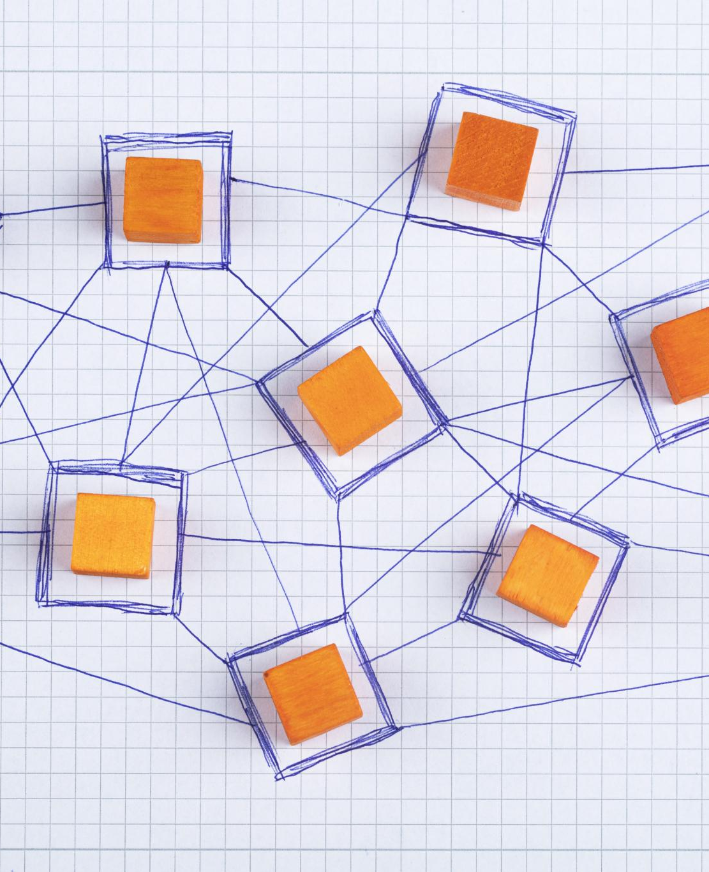
Examples of Generation Models
GPT-3
GPT-3 is a state-of-the-art language model based on transformer architectures and is one of the most powerful models in RAG. It has been used for a variety of NLP tasks, including text generation and language translation.
T5
T5 is a sequence-to-sequence model that can perform a variety of NLP tasks, such as text summarization, language translation, and question answering. It is used extensively in RAG and is known for its versatility and accuracy.
BART
BART is a generative model used in RAG that is based on transformer architectures. It has been used for a variety of NLP tasks, such as text summarization and language translation, and is known for its high performance and accuracy.
GShard
GShard is a distributed training framework used in RAG that can handle large-scale models and training data. It is known for its scalability and efficiency and has been used to train some of the largest language models to date.
Notes:
Some examples of generation models used in RAG include GPT-3, which is a powerful language model based on transformer architectures, and T5, which is a sequence-to-sequence model that can perform a variety of NLP tasks. Other models, such as BART and GShard, are also used in RAG.

Slide 15
RAG Training and Fine-Tuning
Notes:
RAG models require significant training and fine-tuning to achieve optimal performance. In this section, we will explore the different training pipelines and fine-tuning techniques used in RAG, along with the performance evaluation metrics.

Slide 16

Training Pipelines
Supervised and Unsupervised Techniques
RAG models are trained using a combination of supervised and unsupervised learning techniques, such as pre-training the retrieval component using unsupervised techniques like BERT and fine-tuning the generation component using supervised learning techniques like maximum likelihood estimation.
Pre-Training with Large-Scale Techniques
Unsupervised learning techniques like BERT are used to pre-train the retrieval component of RAG models. BERT is a large-scale technique that enables models to learn contextual relations between words or subwords in a sentence.
Fine-Tuning with Supervised Learning
Supervised learning techniques like maximum likelihood estimation are used to fine-tune the generation component of RAG models. Maximum likelihood estimation is a technique used to estimate the parameters of a probability distribution.
Notes:
RAG models are typically trained using a combination of supervised and unsupervised techniques. The retrieval component can be pre-trained using large-scale unsupervised learning techniques, such as BERT, while the generation component can be fine-tuned using supervised learning techniques, such as maximum likelihood estimation. The training pipeline depends on the specific application and the type of text output required.

Slide 17
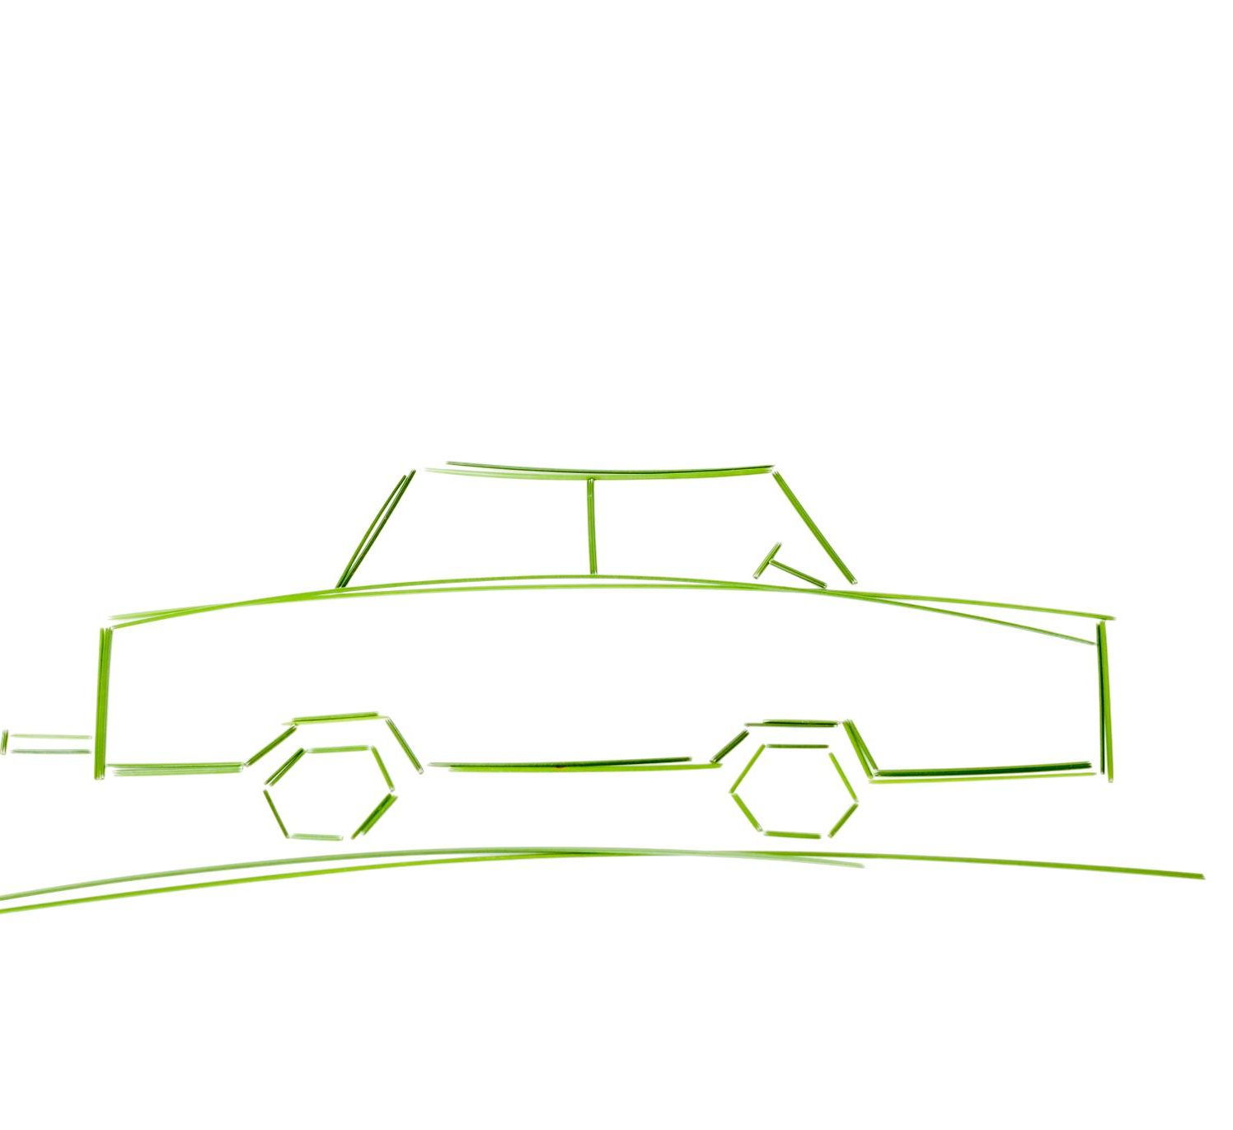
Fine-Tuning Techniques
Transfer Learning
Transfer learning is a fine-tuning technique that involves using knowledge learned from one domain or task to improve the performance of the model on a new domain or task. It can be useful when there is limited labeled data available for the new task.
Multi-Task Learning
Multi-task learning is a fine-tuning technique that involves training the model to perform multiple related tasks simultaneously, which can help improve the performance of the model by leveraging shared information across tasks.
Reinforcement Learning
Reinforcement learning is a fine-tuning technique that involves training the model to make decisions based on rewards and punishments, which can help improve the performance of the model in dynamic environments.
Notes:
RAG models can be fine-tuned using a variety of techniques, such as transfer learning, multi-task learning, and reinforcement learning. These techniques can help improve the performance of the model by adapting it to the specific task and domain. The choice of fine-tuning technique depends on the specific application and the type of text output required.

Slide 18
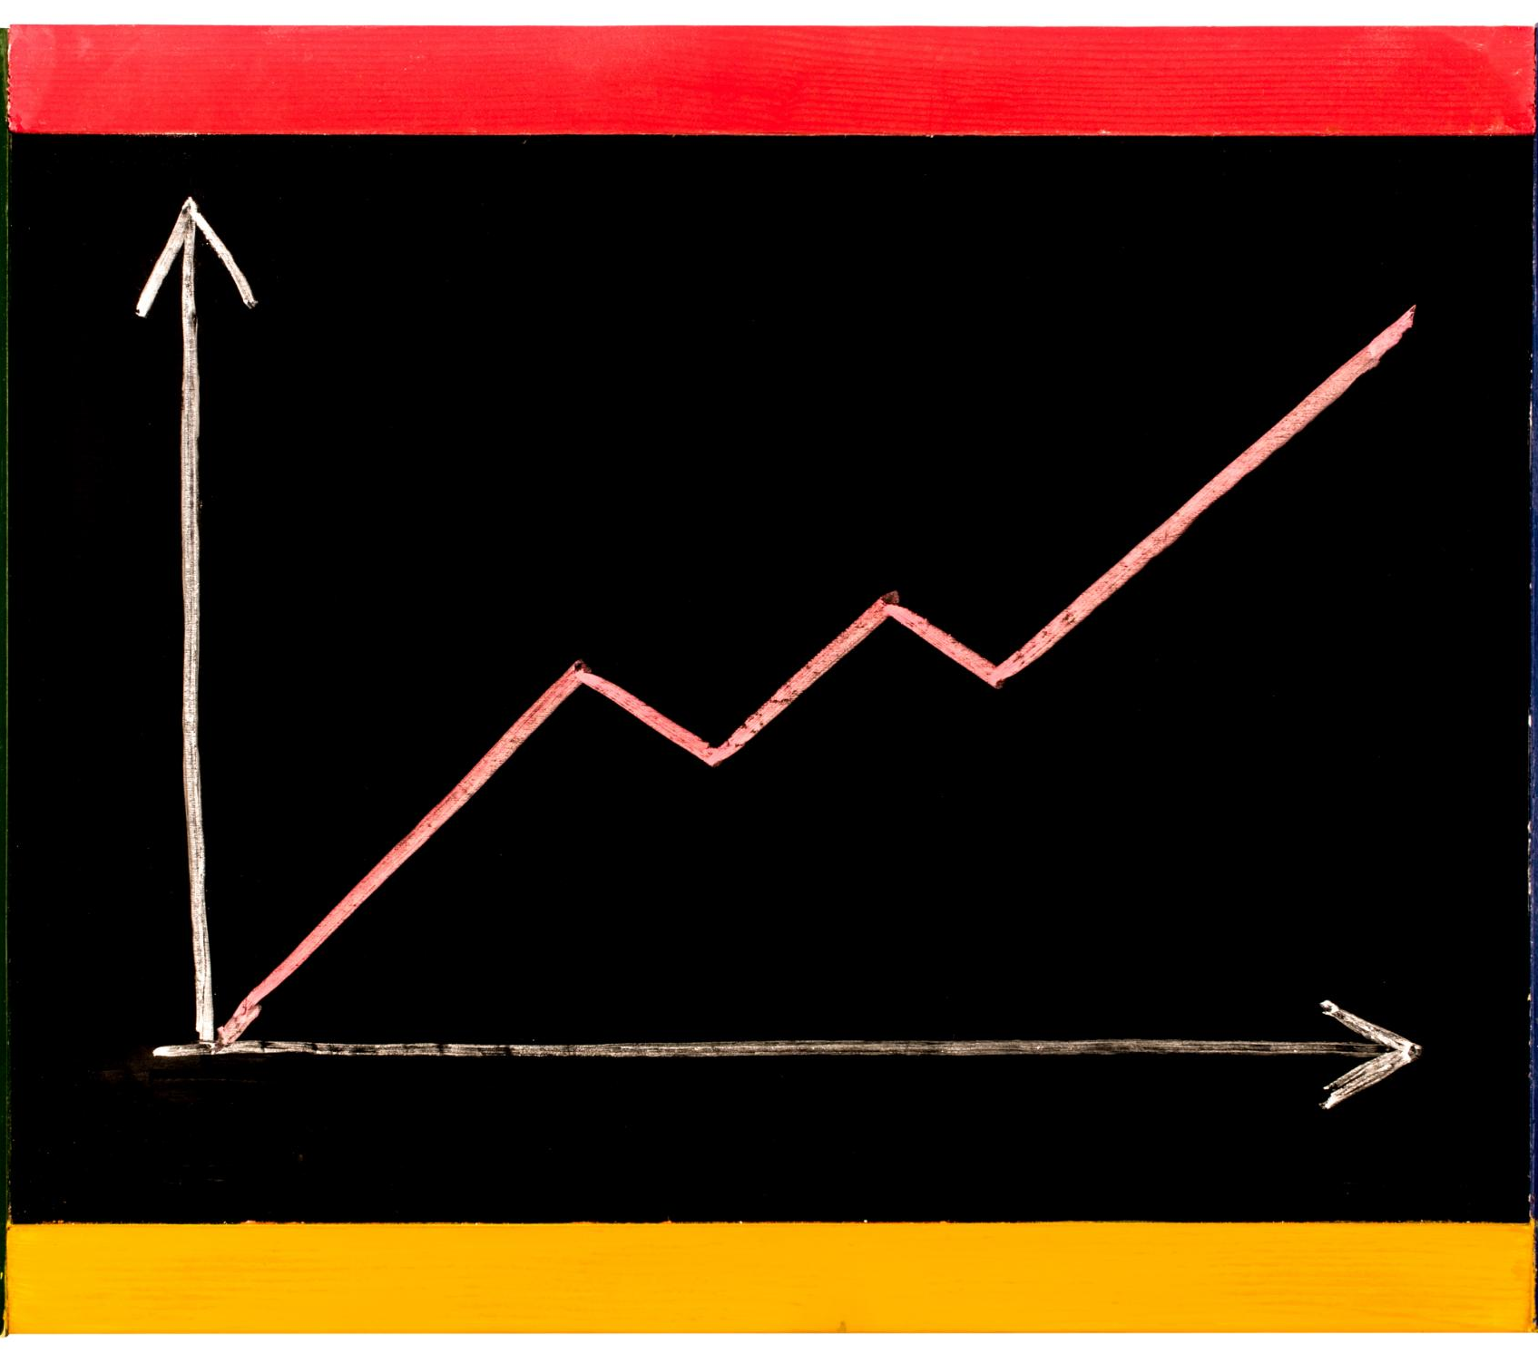
Performance Evaluation Metrics
RAG models can be evaluated using metrics such as accuracy, precision, recall, and F1 score, which provide insights into the quality of generated text and the relevance of the retrieved information.
Notes:
The performance of RAG models can be evaluated using a variety of metrics, such as accuracy, precision, recall, and F1 score. These metrics can help assess the quality of the generated text and the relevance of the retrieved information. The choice of evaluation metric depends on the specific application and the type of text output required.

Slide 19
Applications and Use Cases
Notes:
RAG has a wide range of potential applications and use cases in NLP. In this section, we will explore some of the most common applications of RAG, such as customer support and chatbots, content generation and summarization, and open-domain question answering.

Slide 20

Customer Support and Chatbots
RAG for Customer Support
Utilizing RAG can improve the quality of customer support by providing more accurate and informative responses to user queries, resulting in higher satisfaction and retention rates.
RAG for Chatbots
Integrating RAG can enhance the capabilities of chatbots by enabling more context-specific text generation, leading to better communication and engagement with users.
Notes:
RAG can be used to improve the quality of customer support and chatbots by enabling more accurate and informative text generation. By using a knowledge base or reference corpus to augment the generation process, RAG models can produce more relevant and context-specific text, improving the user experience.

Slide 21

Content Generation and Summarization
Content Generation
RAG can be used to generate informative and engaging content for a variety of applications including news articles, product reviews and scientific papers. It generates the content by paraphrasing the key information from a given input text.
Summarization
RAG models can be used to summarize large amounts of text by selecting the most relevant information from a knowledge base or reference corpus. It helps to choose the most important information from a large text corpus and present it in a concise and understandable manner.
Notes:
RAG can be used to generate informative and engaging content for a variety of applications, such as news articles, product reviews, and scientific papers. RAG models can also be used to summarize large amounts of text by selecting the most relevant information from a knowledge base or reference corpus.

Slide 22
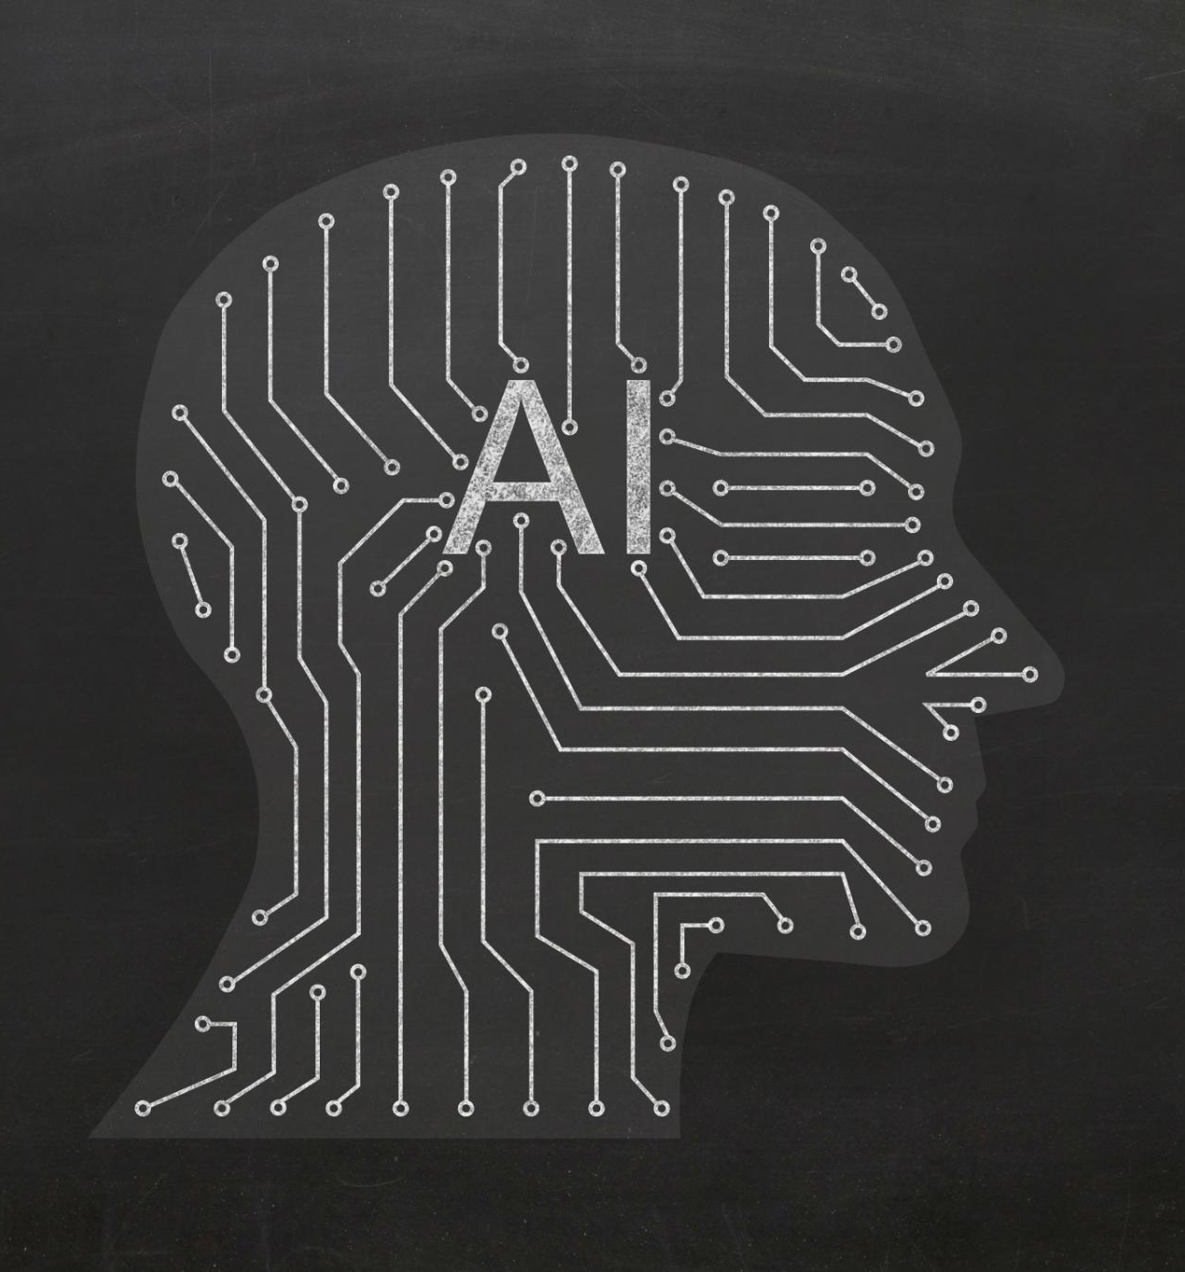
Open-Domain Question Answering
RAG (Retrieval-Augmented Generation) models can improve the accuracy and relevance of open-domain question answering systems by retrieving relevant information from a knowledge base or reference corpus to produce more accurate and informative answers to a wide range of questions.
Notes:
RAG can be used to improve the accuracy and relevance of open-domain question answering systems. By using a knowledge base or reference corpus to retrieve relevant information, RAG models can produce more accurate and informative answers to a wide range of questions.

Slide 23
Future Directions and Challenges
Notes:
RAG is an emerging field of NLP with many exciting opportunities and challenges. In this section, we will explore some of the future directions and challenges of RAG, such as scalability and efficiency, handling diverse and large datasets, and ethical considerations and biases.

Slide 24

Scalability and Efficiency
RAG models face challenges with scalability and efficiency, becoming computationally expensive and time-consuming as the size of knowledge bases and complexity of generation tasks increase.
Notes:
One of the main challenges of RAG is scalability and efficiency. As the size of the knowledge base and the complexity of the generation task increase, RAG models can become computationally expensive and time-consuming. New techniques, such as distributed training and model compression, are being developed to address this challenge.

Slide 25

Handling Diverse and Large Datasets
Data Preprocessing
To handle diverse and large datasets, new techniques for data preprocessing are required, including data cleaning, normalization, and feature extraction.
Knowledge Base Selection
Selecting the right knowledge base is essential to effectively handle diverse and large datasets. This requires careful consideration of factors such as data structure, data quality, and domain-specific knowledge.
Model Architecture
To handle diverse and large datasets, RAG models need to be designed with new model architectures, including deep neural networks, hierarchical models, and ensemble models.
Large-Scale Annotated Datasets
The development of large-scale annotated datasets, such as Natural Questions and TriviaQA, is helping to improve the performance of RAG models by providing a large amount of high-quality training data.
Notes:
RAG models must be able to handle diverse and large datasets to be effective in real-world applications. This requires new techniques for data preprocessing, knowledge base selection, and model architecture. The development of large-scale annotated datasets, such as Natural Questions and TriviaQA, is also helping to improve the performance of RAG models.

Slide 26

Ethical Considerations and Biases
Privacy and Security
Privacy and security are major ethical considerations in the development and deployment of RAG models, as they deal with sensitive information and user data. It is important to design and implement security measures that protect user data and privacy.
Bias and Fairness
Bias and fairness are important ethical considerations when designing RAG models. It is important to identify and mitigate any potential biases in the data used to train the model and ensure that the model is fair and unbiased in its predictions.
Multidisciplinary Approach
Developing and deploying RAG models responsibly requires a multidisciplinary approach that involves experts in ethics, law, and social science. This approach ensures that all ethical considerations are taken into account and the model is designed and deployed in a responsible manner.
Notes:
As with any AI system, RAG models must be developed and used responsibly. Ethical considerations, such as privacy, bias, and fairness, must be taken into account when designing and deploying RAG models. This requires a multidisciplinary approach that involves experts in ethics, law, and social science.

